Slide 1
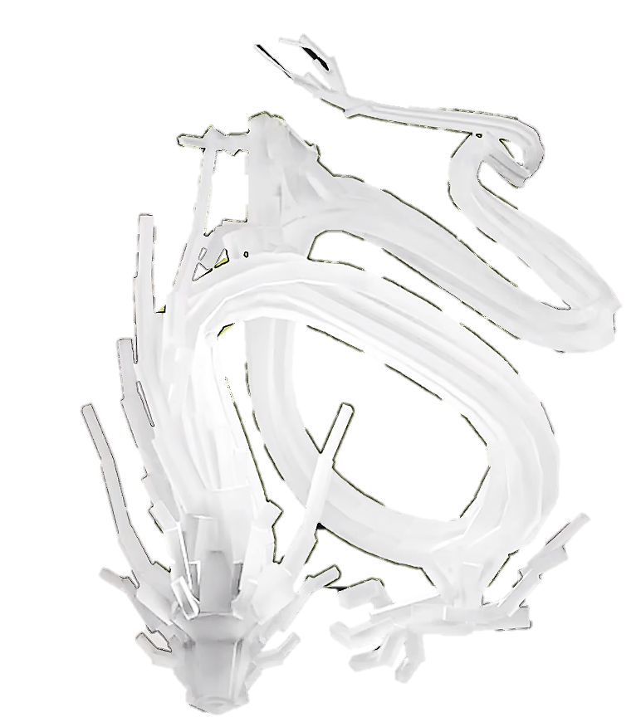


Traffic Flow Dynamic
Gong Ziyang

Slide 2

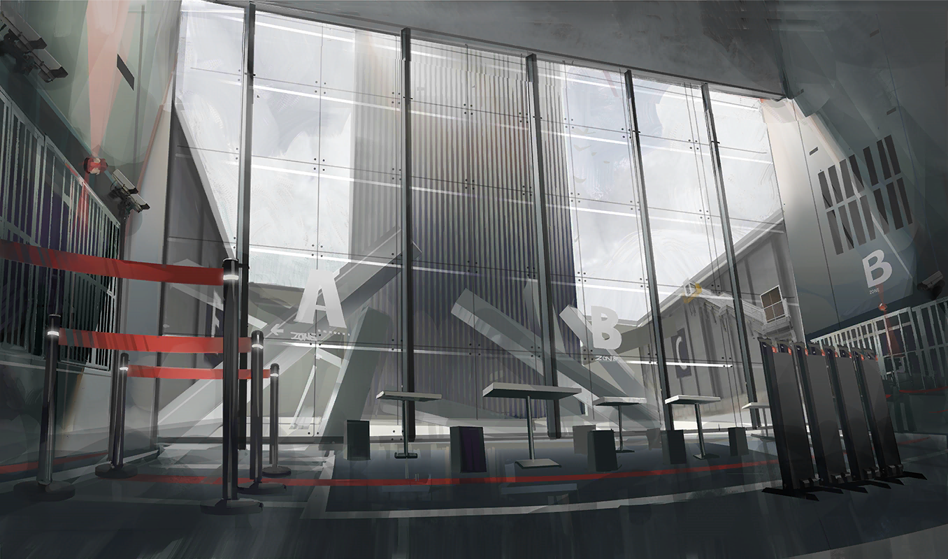
rhodeskesi
Chapt6. General Aspects
建议使用：带图小标题
可以修改右侧文字 介绍
英文字体：Novecento wide
中文字体：思源黑体

Slide 3
6.1 Model Classification
rhodeskesi
Traffic flow models can be categorized with respect to a number of aspects:
Aggregation level
Mathematical structure
Conceptual aspects

Slide 4
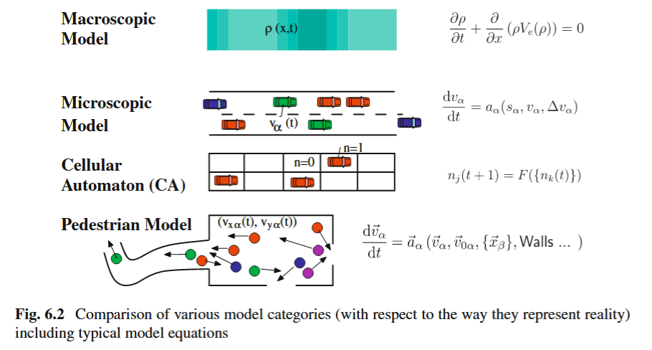
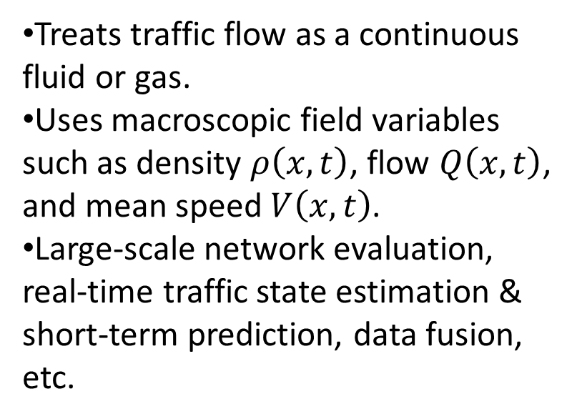
6.1.1 Model Classification-Aggregation Level
rhodeskesi
Macroscopic models(hydrodynamic models)
Treats traffic flow as a continuous fluid or gas.
Uses macroscopic field variables such as density $ρ\left(x,t\right)$, flow $Q\left(x,t\right)$, and mean speed $V\left(x,t\right)$.
Large-scale network evaluation, real-time traffic state estimation & short-term prediction, data fusion, etc.

Slide 5
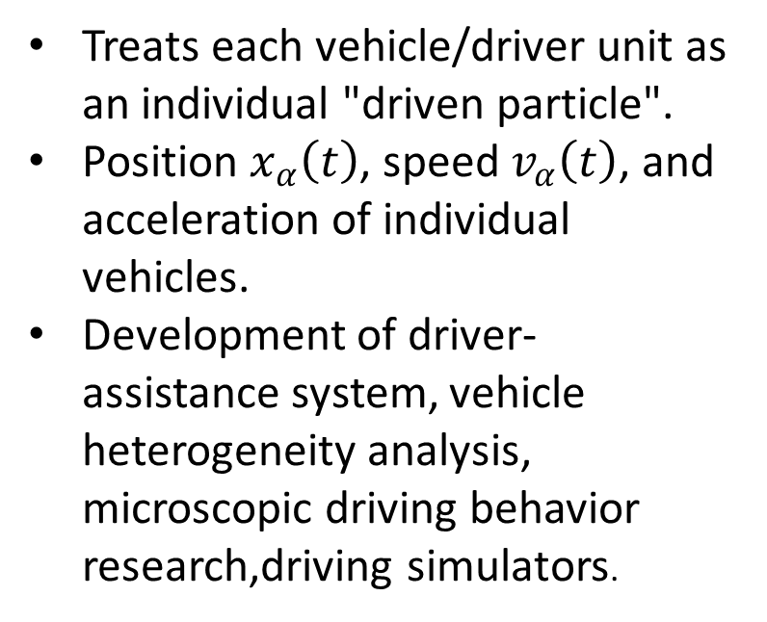
6.1.1 Model Classification-Aggregation Level
rhodeskesi
Microscopic Models
Treats each vehicle/driver unit as an individual "driven particle".
Position $x_{α}\left(t\right)$, speed $v_{α}\left(t\right)$, and acceleration of individual vehicles.
Development of driver-assistance system, vehicle heterogeneity analysis, microscopic driving behavior research,driving simulators.

Slide 6
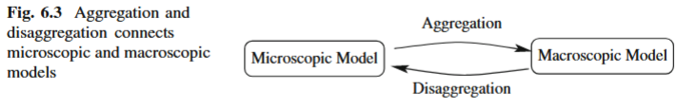
6.1.1 Model Classification-Aggregation Level
rhodeskesi
Mesoscopic models:
Aggregation: Microscopically large
Macroscopically small
Disaggregation:information of microscopic higher than that of macroscopic.

Slide 7
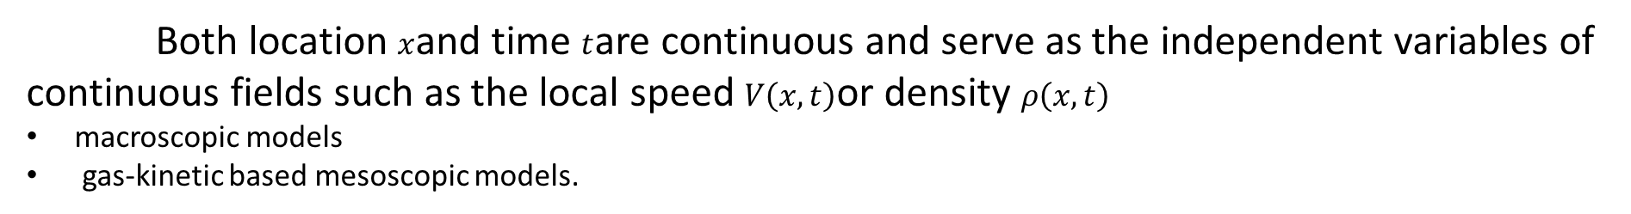
6.1.2 Model Classification-Mathematical Structure
rhodeskesi
Partial differential equations:
Both location $x$and time $t$are continuous and serve as the independent variables of continuous fields such as the local speed $V\left(x,t\right)$or density $ρ\left(x,t\right)$
macroscopic models
gas-kinetic based mesoscopic models.
Static Models / Traffic Stream Models:
Describes paired, static equilibrium relationships between macroscopic state variables
The foundation for route choice in traditional traffic planning

Slide 8
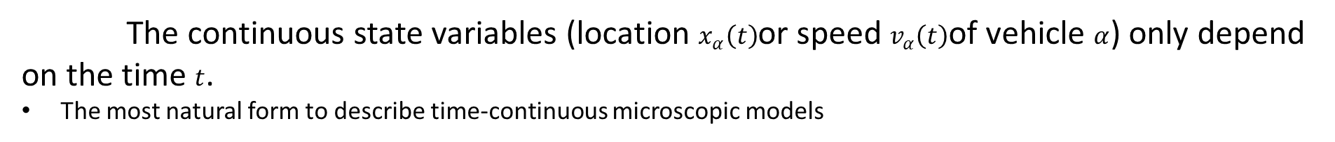
6.1.2 Model Classification-Mathematical Structure
rhodeskesi
Coupled ordinary differential equations:
The continuous state variables (location $x_{α}\left(t\right)$or speed $v_{α}\left(t\right)$of vehicle $α$) only depend on the time $t$.
The most natural form to describe time-continuous microscopic models
Cellular automata:
All variables are discrete. Space is partitioned into fixed cells (state is 0 or 1), and time updates at fixed intervals.
Used for microscopic models
Discrete State Variables, Continuous Time:
State variables take discrete values, while time remains continuous.
Used for lane-changing submodels
mesoscopic models

Slide 9
6.2 Other Criteria
rhodeskesi
Randomness:
Deterministic models vs. Stochastic models.
Identical and heterogeneous drivers/vehicles:
Single vehicle type/driving style vs. heterogeneous traffic flow containing multiple vehicle types and driving styles
Constant vs. variable driving behavior:
Fixed parameters vs. parameters dynamically adjusted over time or driving environment

Slide 10
6.3 Non-Motorized Traffic
rhodeskesi
Generally, the microscopic approach is most suitable. large events with unidirectional traffic flow have also been modeled and simulated macroscopically
In addition to the walking speed, every pedestrian also has a desired direction. Consequently, the desired velocity is a vectorial quantity.

Slide 11
rhodeskesi
Chapt7. Continuity Equation
建议使用：带图小标题
可以修改右侧文字 介绍
英文字体：Novecento wide
中文字体：思源黑体

Slide 12
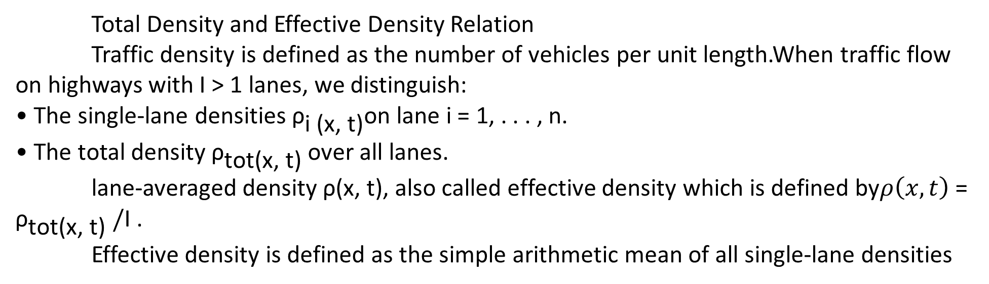
7.1 Traffic Density and Hydrodynamic Flow-Density Relation
rhodeskesi
Total Density and Effective Density Relation
Traffic density is defined as the number of vehicles per unit length.When traffic flow on highways with I > 1 lanes, we distinguish:
• The single-lane densities ${\text{ρ}}_{\text{i}\text{ (}\text{x}\text{, }\text{t}\text{)}}$on lane i = 1, . . . , n.
• The total density ${\text{ρ}}_{\text{tot}\text{(}\text{x}\text{, }\text{t}\text{)}}$over all lanes.
lane-averaged density ρ(x, t), also called effective density which is defined by$ρ\left(x,t\right)$= ${\text{ρ}}_{\text{tot}\text{(}\text{x}\text{, }\text{t}\text{)}} /$I .
Effective density is defined as the simple arithmetic mean of all single-lane densities
$$ρ_{tot}\left(x,t\right)=\sum_{i=1}^{I}{ρ_{i}}\left(x,t\right)=Iρ\left(x,t\right)$$

Slide 13
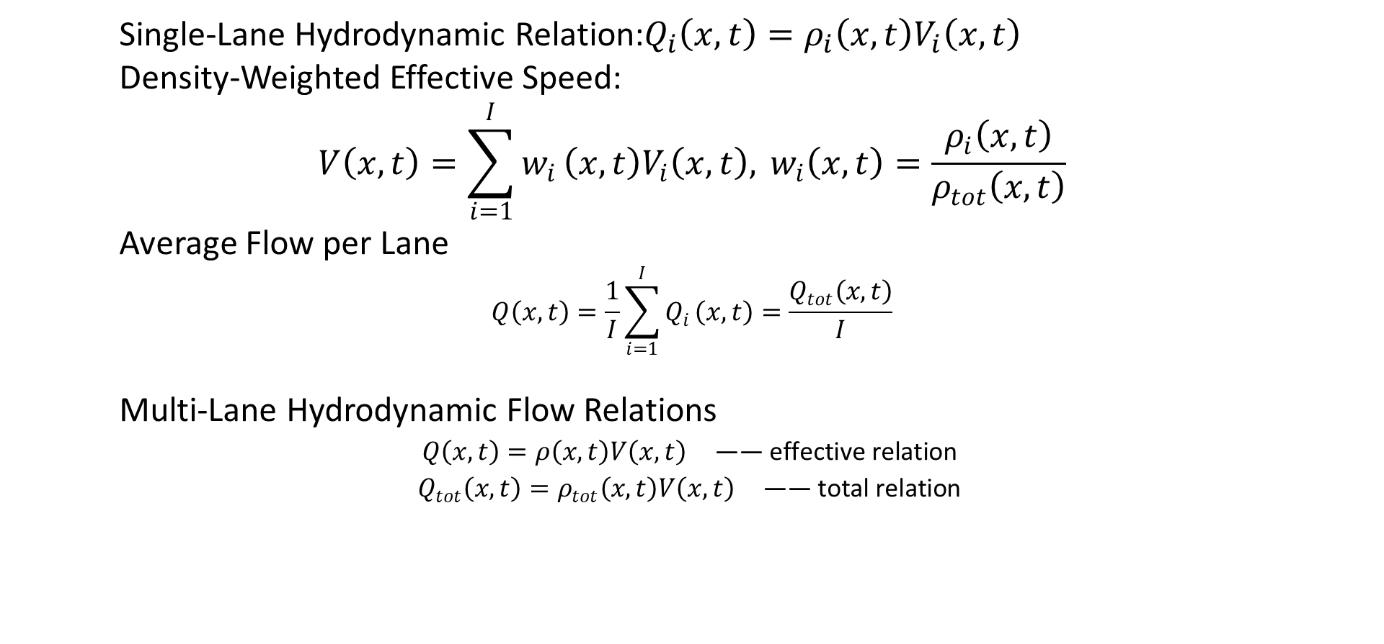
7.1 Traffic Density and Hydrodynamic Flow-Density Relation
rhodeskesi
Single-Lane Hydrodynamic Relation:$Q_{i}\left(x,t\right)=ρ_{i}\left(x,t\right)V_{i}\left(x,t\right)$
Density-Weighted Effective Speed:
$$V\left(x,t\right)=\sum_{i=1}^{I}{w_{i}}\left(x,t\right)V_{i}\left(x,t\right), w_{i}\left(x,t\right)=\frac{ρ_{i}\left(x,t\right)}{ρ_{tot}\left(x,t\right)}$$
Average Flow per Lane
$$Q\left(x,t\right)=\frac{1}{I}\sum_{i=1}^{I}{Q_{i}}\left(x,t\right)=\frac{Q_{tot}\left(x,t\right)}{I}$$
Multi-Lane Hydrodynamic Flow Relations
$$Q\left(x,t\right)=ρ\left(x,t\right)V\left(x,t\right) \text{—— }\text{effective} \text{relation}$$
$$Q_{tot}\left(x,t\right)=ρ_{tot}\left(x,t\right)V\left(x,t\right) \text{—— }\text{total} \text{relation}$$

Slide 14
7.2 Continuity Equations for Several Road
rhodeskesi
The continuity equation does not depend on the particular macroscopic model being used, but on the geometry of the road infrastructure.
homogeneous road section
highway with on- or off-ramps
road section in which the number of lanes changes

Slide 15
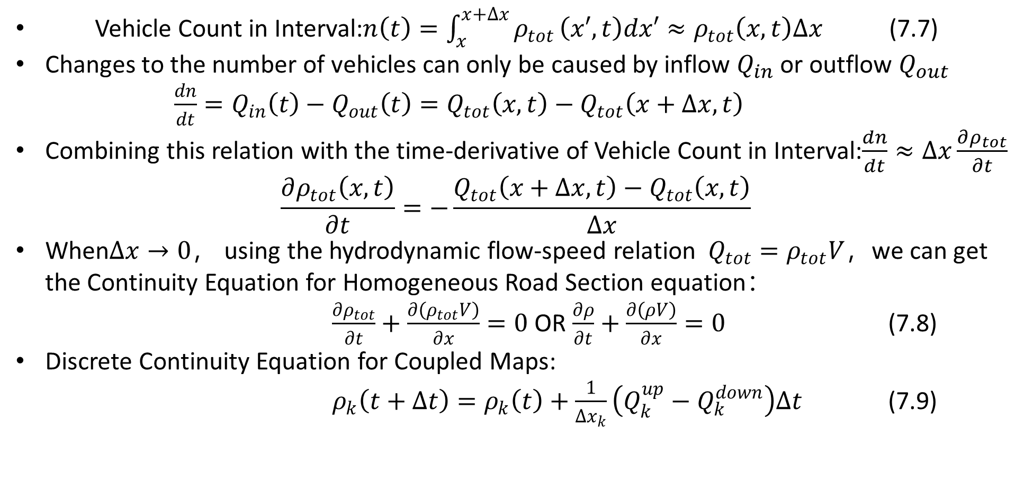
7.2.1 Continuity Equations for Several Road-homogeneous road section
rhodeskesi
Vehicle Count in Interval:$n\left(t\right)=\int_{x}^{x+Δx}{ρ_{tot}}\left(x′,t\right)dx′≈ρ_{tot}\left(x,t\right)Δx$ (7.7)
Changes to the number of vehicles can only be caused by inflow $Q_{in}$ or outflow $Q_{out}$ $\frac{dn}{dt}=Q_{in}\left(t\right)−Q_{out}\left(t\right)=Q_{tot}\left(x,t\right)−Q_{tot}\left(x+Δx,t\right)$
Combining this relation with the time-derivative of Vehicle Count in Interval:$\frac{dn}{dt}≈Δx\frac{∂ρ_{tot}}{∂t}$
$$\frac{∂ρ_{tot}\left(x,t\right)}{∂t}=−\frac{Q_{tot}\left(x+Δx,t\right)−Q_{tot}\left(x,t\right)}{Δx}$$
When$Δx→0$， using the hydrodynamic flow-speed relation $Q_{tot}=ρ_{tot}V$，we can get the Continuity Equation for Homogeneous Road Section equation：
$\frac{∂ρ_{tot}}{∂t}+\frac{∂\left(ρ_{tot}V\right)}{∂x}=0$ OR $\frac{∂ρ}{∂t}+\frac{∂\left(ρV\right)}{∂x}=0$ (7.8)
Discrete Continuity Equation for Coupled Maps:
$ρ_{k}\left(t+Δt\right)=ρ_{k}\left(t\right)+\frac{1}{Δx_{k}}\left(Q_{k}^{up}−Q_{k}^{down}\right)Δt$ (7.9)

Slide 16
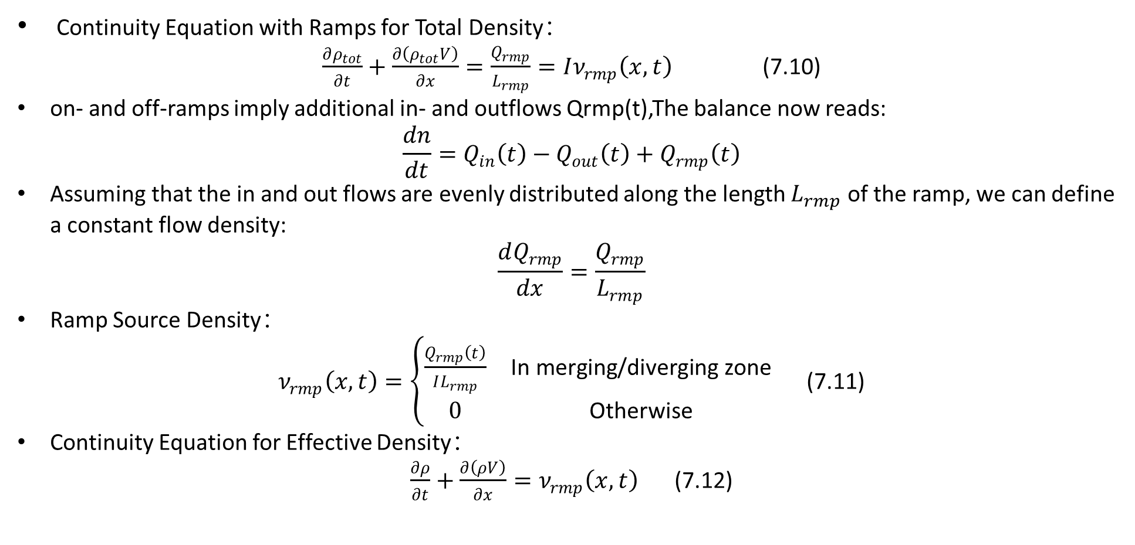
7.2.2 Sections with On- and Off-Ramps
rhodeskesi
Continuity Equation with Ramps for Total Density：
$\frac{∂ρ_{tot}}{∂t}+\frac{∂\left(ρ_{tot}V\right)}{∂x}=\frac{Q_{rmp}}{L_{rmp}}=Iν_{rmp}\left(x,t\right)$ (7.10)
on- and off-ramps imply additional in- and outflows Qrmp(t),The balance now reads:
$$\frac{dn}{dt}=Q_{in}\left(t\right)−Q_{out}\left(t\right)+Q_{rmp}\left(t\right)$$
Assuming that the in and out flows are evenly distributed along the length $L_{rmp}$of the ramp, we can define a constant flow density:
$$\frac{dQ_{rmp}}{dx}=\frac{Q_{rmp}}{L_{rmp}}$$
Ramp Source Density：
$ν_{rmp}\left(x,t\right)=\left\{\begin{matrix}\frac{Q_{rmp}\left(t\right)}{IL_{rmp}} & \text{In} \text{merging}\text{/}\text{diverging} \text{zone} \\ 0 & \text{Otherwise}\end{matrix}\right.$ (7.11)
Continuity Equation for Effective Density：
$\frac{∂ρ}{∂t}+\frac{∂\left(ρV\right)}{∂x}=ν_{rmp}\left(x,t\right)$ (7.12)

Slide 17
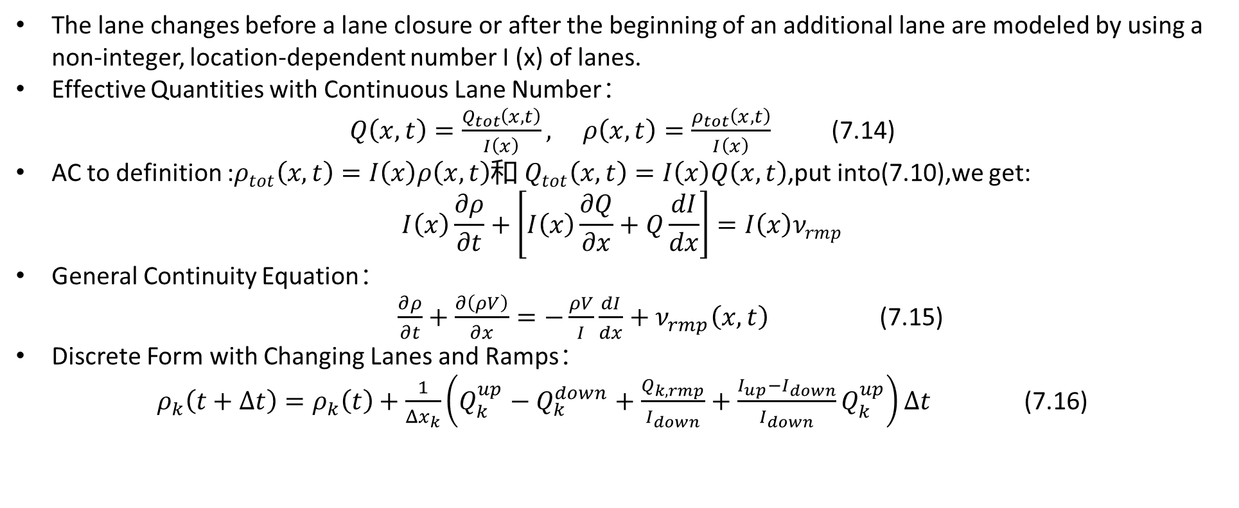
7.2.3 Changes in the Number of Lanes
rhodeskesi
The lane changes before a lane closure or after the beginning of an additional lane are modeled by using a non-integer, location-dependent number I (x) of lanes.
Effective Quantities with Continuous Lane Number：
$Q\left(x,t\right)=\frac{Q_{tot}\left(x,t\right)}{I\left(x\right)}, ρ\left(x,t\right)=\frac{ρ_{tot}\left(x,t\right)}{I\left(x\right)}$ (7.14)
AC to definition :$ρ_{tot}\left(x,t\right)=I\left(x\right)ρ\left(x,t\right)$和 $Q_{tot}\left(x,t\right)=I\left(x\right)Q\left(x,t\right)$,put into(7.10),we get:
$$I\left(x\right)\frac{∂ρ}{∂t}+\left[I\left(x\right)\frac{∂Q}{∂x}+Q\frac{dI}{dx}\right]=I\left(x\right)ν_{rmp}$$
General Continuity Equation：
$\frac{∂ρ}{∂t}+\frac{∂\left(ρV\right)}{∂x}=−\frac{ρV}{I}\frac{dI}{dx}+ν_{rmp}\left(x,t\right)$ (7.15)
Discrete Form with Changing Lanes and Ramps：
$ρ_{k}\left(t+Δt\right)=ρ_{k}\left(t\right)+\frac{1}{Δx_{k}}\left(Q_{k}^{up}−Q_{k}^{down}+\frac{Q_{k,rmp}}{I_{down}}+\frac{I_{up}−I_{down}}{I_{down}}Q_{k}^{up}\right)Δt$ (7.16)

Slide 18
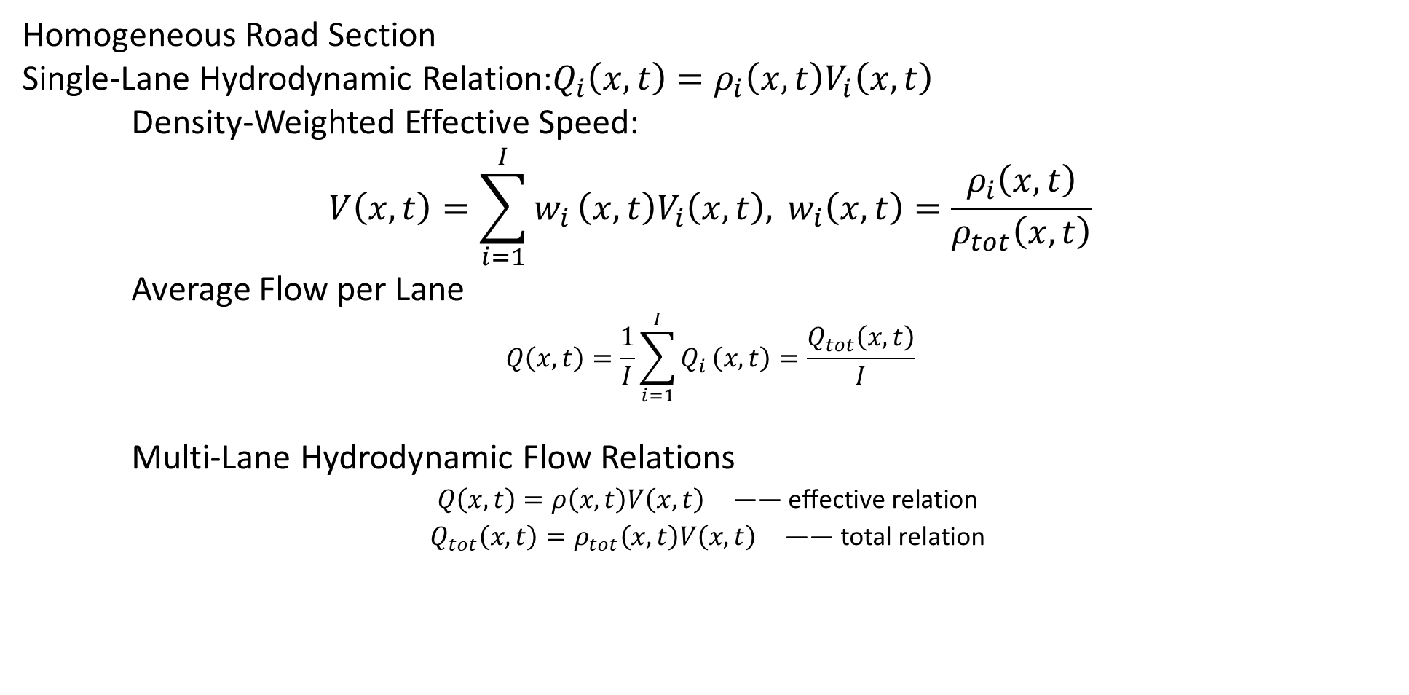
7.2.3 Homogeneous Road Section
rhodeskesi
Homogeneous Road Section
Single-Lane Hydrodynamic Relation:$Q_{i}\left(x,t\right)=ρ_{i}\left(x,t\right)V_{i}\left(x,t\right)$
Density-Weighted Effective Speed:
$$V\left(x,t\right)=\sum_{i=1}^{I}{w_{i}}\left(x,t\right)V_{i}\left(x,t\right), w_{i}\left(x,t\right)=\frac{ρ_{i}\left(x,t\right)}{ρ_{tot}\left(x,t\right)}$$
Average Flow per Lane
$$Q\left(x,t\right)=\frac{1}{I}\sum_{i=1}^{I}{Q_{i}}\left(x,t\right)=\frac{Q_{tot}\left(x,t\right)}{I}$$
Multi-Lane Hydrodynamic Flow Relations
$$Q\left(x,t\right)=ρ\left(x,t\right)V\left(x,t\right) \text{—— }\text{effective} \text{relation}$$
$$Q_{tot}\left(x,t\right)=ρ_{tot}\left(x,t\right)V\left(x,t\right) \text{—— }\text{total} \text{relation}$$

Slide 19
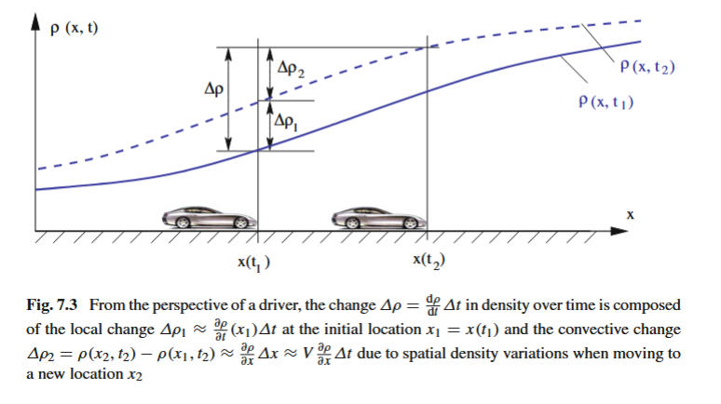
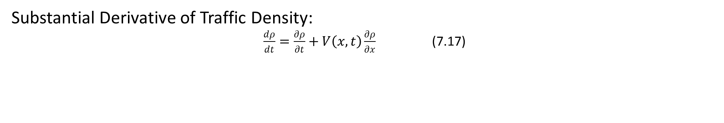
7.3 Continuity Equation from the Driver’s Perspective
rhodeskesi
Substantial Derivative of Traffic Density:
$\frac{dρ}{dt}=\frac{∂ρ}{∂t}+V\left(x,t\right)\frac{∂ρ}{∂x}$ (7.17)

Slide 20
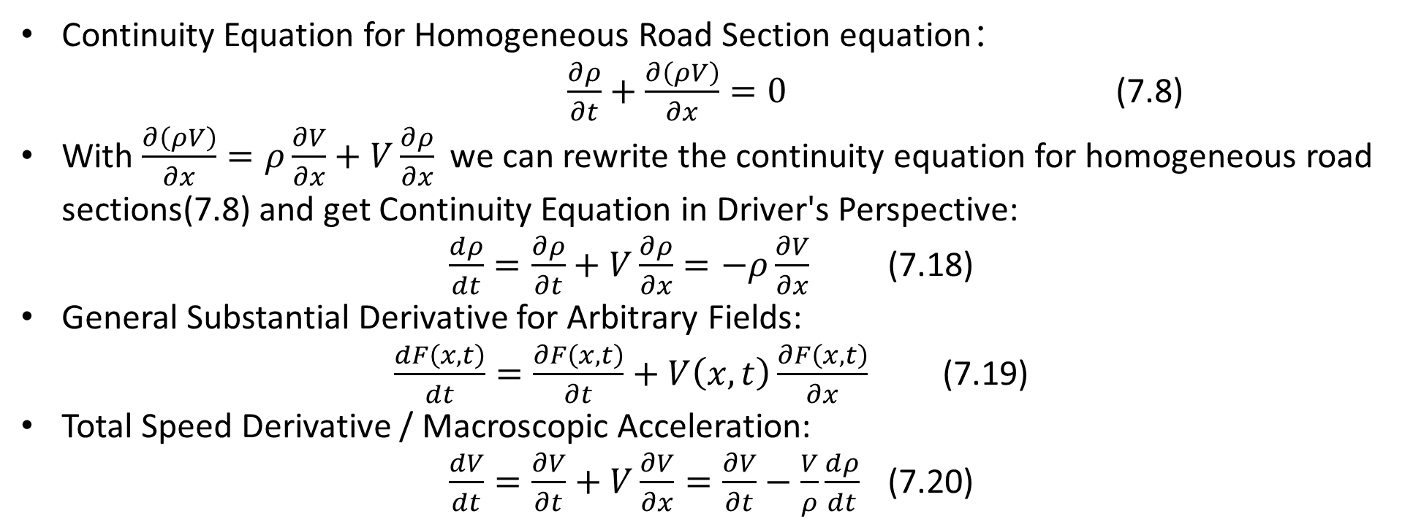
7.3 Continuity Equation from the Driver’s Perspective
rhodeskesi
Continuity Equation for Homogeneous Road Section equation：
$\frac{∂ρ}{∂t}+\frac{∂\left(ρV\right)}{∂x}=0$ (7.8)
With $\frac{∂\left(ρV\right)}{∂x}=ρ\frac{∂V}{∂x}+V\frac{∂ρ}{∂x}$we can rewrite the continuity equation for homogeneous road sections(7.8) and get Continuity Equation in Driver's Perspective:
$\frac{dρ}{dt}=\frac{∂ρ}{∂t}+V\frac{∂ρ}{∂x}=−ρ\frac{∂V}{∂x}$ (7.18)
General Substantial Derivative for Arbitrary Fields:
$\frac{dF\left(x,t\right)}{dt}=\frac{∂F\left(x,t\right)}{∂t}+V\left(x,t\right)\frac{∂F\left(x,t\right)}{∂x}$ (7.19)
Total Speed Derivative / Macroscopic Acceleration:
$\frac{dV}{dt}=\frac{∂V}{∂t}+V\frac{∂V}{∂x}=\frac{∂V}{∂t}−\frac{V}{ρ}\frac{dρ}{dt}$ (7.20)

Slide 21
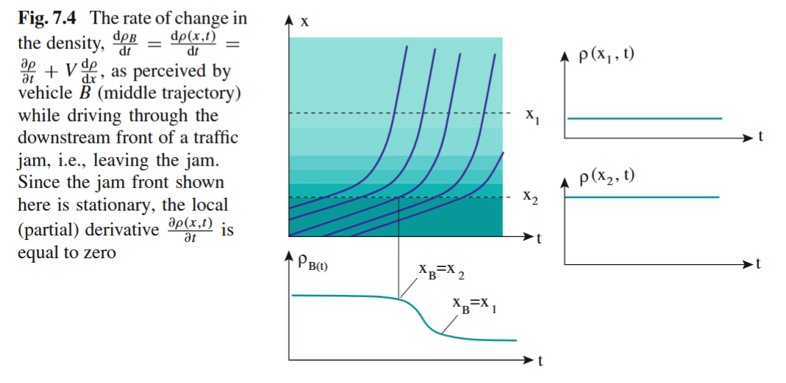
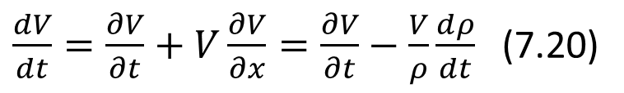
7.3 Continuity Equation from the Driver’s Perspective
rhodeskesi
$\frac{dV}{dt}=\frac{∂V}{∂t}+V\frac{∂V}{∂x}=\frac{∂V}{∂t}−\frac{V}{ρ}\frac{dρ}{dt}$ (7.20)

Slide 22
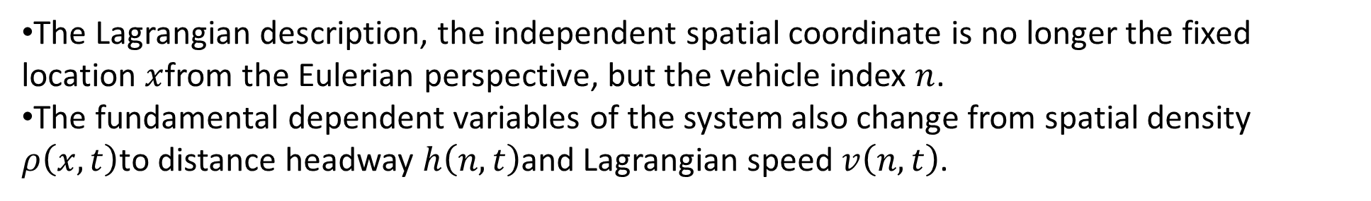
7.4 Lagrangian Description
rhodeskesi
The Lagrangian description, the independent spatial coordinate is no longer the fixed location $x$from the Eulerian perspective, but the vehicle index $n$.
The fundamental dependent variables of the system also change from spatial density $ρ\left(x,t\right)$to distance headway $h\left(n,t\right)$and Lagrangian speed $v\left(n,t\right)$.

Slide 23
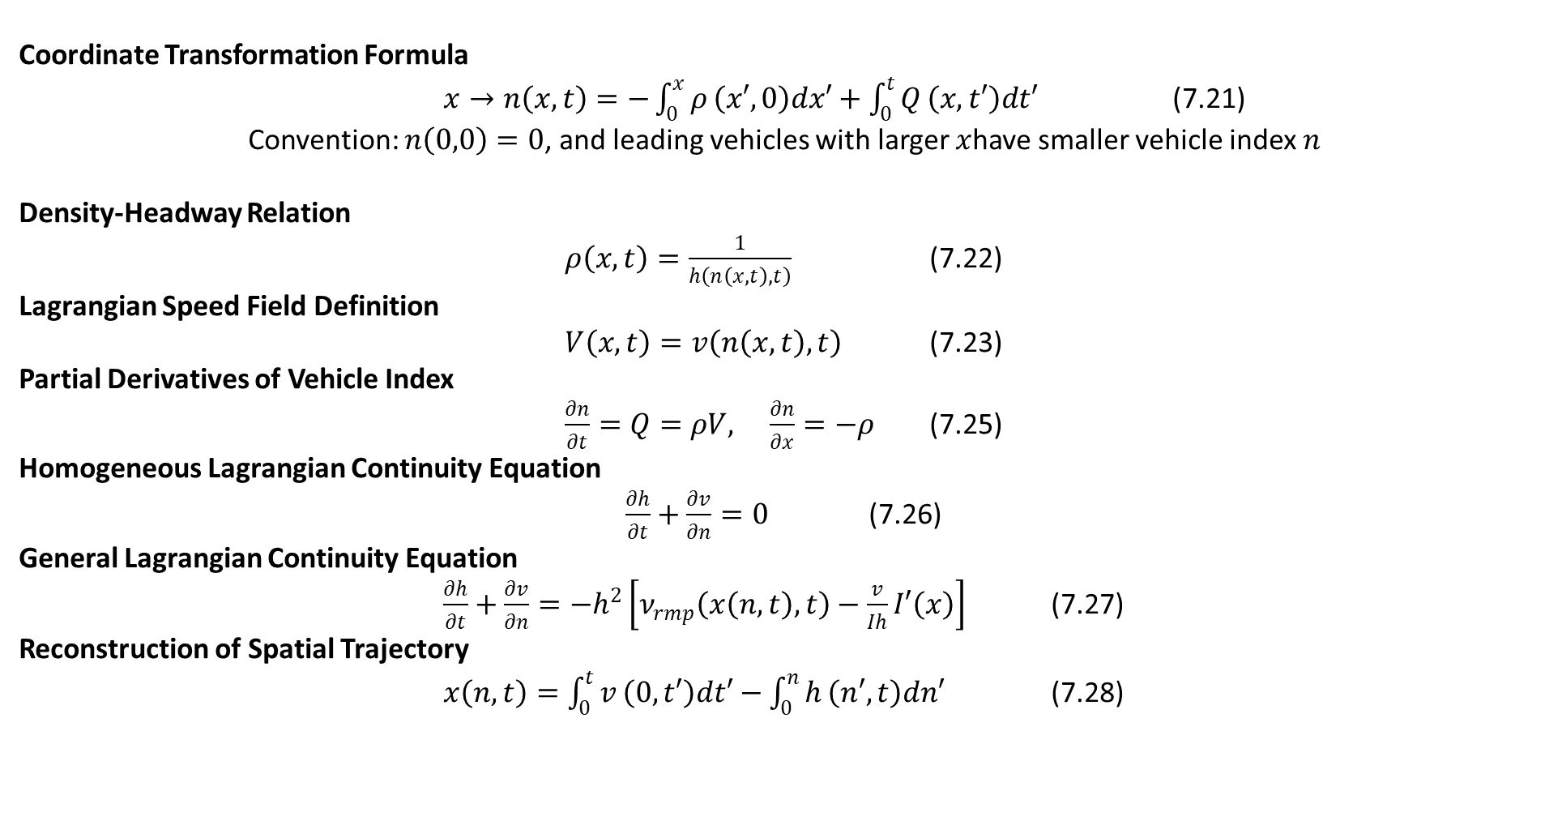
7.4 Lagrangian Description
rhodeskesi
Coordinate Transformation Formula
$x→n\left(x,t\right)=−\int_{0}^{x}{ρ}\left(x′,0\right)dx′+\int_{0}^{t}{Q}\left(x,t′\right)dt′$ (7.21)
Convention: $n\left(0,0\right)=0$, and leading vehicles with larger $x$have smaller vehicle index $n$
Density-Headway Relation
$ρ\left(x,t\right)=\frac{1}{h\left(n\left(x,t\right),t\right)}$ (7.22)
Lagrangian Speed Field Definition
$V\left(x,t\right)=v\left(n\left(x,t\right),t\right)$ (7.23)
Partial Derivatives of Vehicle Index
$\frac{∂n}{∂t}=Q=ρV, \frac{∂n}{∂x}=−ρ$ (7.25)
Homogeneous Lagrangian Continuity Equation
$\frac{∂h}{∂t}+\frac{∂v}{∂n}=0$ (7.26)
General Lagrangian Continuity Equation
$\frac{∂h}{∂t}+\frac{∂v}{∂n}=−h^{2}\left[ν_{rmp}\left(x\left(n,t\right),t\right)−\frac{v}{Ih}I′\left(x\right)\right]$ (7.27)
Reconstruction of Spatial Trajectory
$x\left(n,t\right)=\int_{0}^{t}{v}\left(0,t′\right)dt′−\int_{0}^{n}{h}\left(n′,t\right)dn′$ (7.28)

Slide 24
rhodeskesi
Chapt8. The Lighthill–Whitham–Richards Model
建议使用：带图小标题
可以修改右侧文字 介绍
英文字体：Novecento wide
中文字体：思源黑体

Slide 25
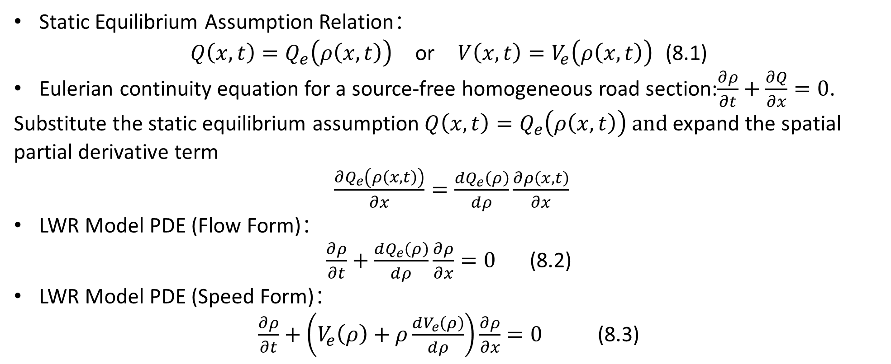
8.1 LWR ModeL
rhodeskesi
Static Equilibrium Assumption Relation：
$Q\left(x,t\right)=Q_{e}\left(ρ\left(x,t\right)\right) \text{or} V\left(x,t\right)=V_{e}\left(ρ\left(x,t\right)\right)$ (8.1)
Eulerian continuity equation for a source-free homogeneous road section:$\frac{∂ρ}{∂t}+\frac{∂Q}{∂x}=0$.
Substitute the static equilibrium assumption $Q\left(x,t\right)=Q_{e}\left(ρ\left(x,t\right)\right) and$expand the spatial partial derivative term
$\frac{∂Q_{e}\left(ρ\left(x,t\right)\right)}{∂x}=\frac{dQ_{e}\left(ρ\right)}{dρ}\frac{∂ρ\left(x,t\right)}{∂x}$
LWR Model PDE (Flow Form)：
$\frac{∂ρ}{∂t}+\frac{dQ_{e}\left(ρ\right)}{dρ}\frac{∂ρ}{∂x}=0$ (8.2)
LWR Model PDE (Speed Form)：
$\frac{∂ρ}{∂t}+\left(V_{e}\left(ρ\right)+ρ\frac{dV_{e}\left(ρ\right)}{dρ}\right)\frac{∂ρ}{∂x}=0$ (8.3)

Slide 26
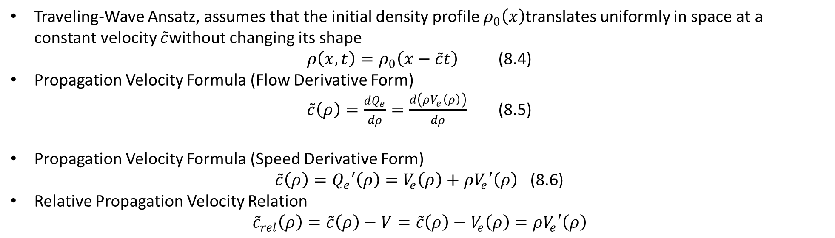
8.2 Propagation of Density Variations
rhodeskesi
Traveling-Wave Ansatz, assumes that the initial density profile $ρ_{0}\left(x\right)$translates uniformly in space at a constant velocity $\overset{˜}{c}$without changing its shape
$ρ\left(x,t\right)=ρ_{0}\left(x−\overset{˜}{c}t\right)$ (8.4)
Propagation Velocity Formula (Flow Derivative Form)
$\overset{˜}{c}\left(ρ\right)=\frac{dQ_{e}}{dρ}=\frac{d\left(ρV_{e}\left(ρ\right)\right)}{dρ}$ (8.5)
Propagation Velocity Formula (Speed Derivative Form)
$\overset{˜}{c}\left(ρ\right)=Q_{e}′\left(ρ\right)=V_{e}\left(ρ\right)+ρV_{e}′\left(ρ\right)$ (8.6)
Relative Propagation Velocity Relation
$${\overset{˜}{c}}_{rel}\left(ρ\right)=\overset{˜}{c}\left(ρ\right)−V=\overset{˜}{c}\left(ρ\right)−V_{e}\left(ρ\right)=ρV_{e}′\left(ρ\right)$$

Slide 27
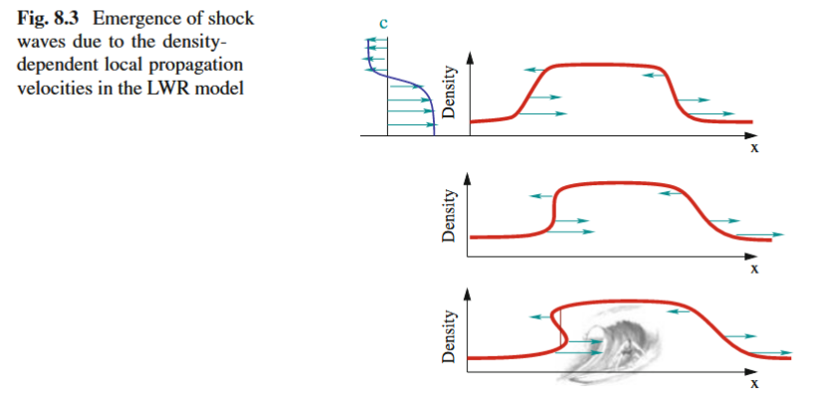
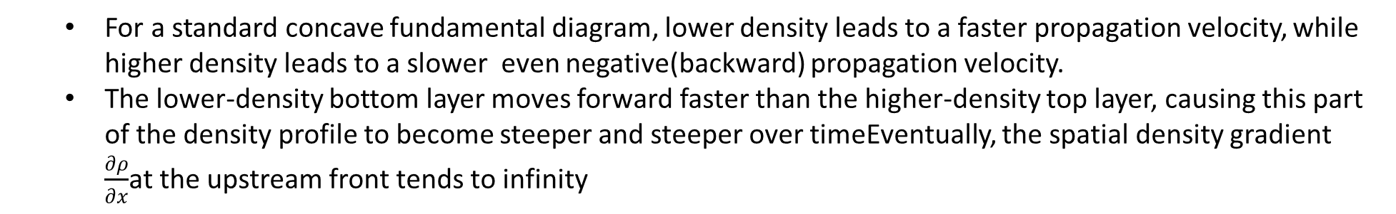
8.3.1 Shock Waves
rhodeskesi
  For a standard concave fundamental diagram, lower density leads to a faster propagation velocity, while higher density leads to a slower even negative(backward) propagation velocity.
  The lower-density bottom layer moves forward faster than the higher-density top layer, causing this part of the density profile to become steeper and steeper over timeEventually, the spatial density gradient $\frac{∂ρ}{∂x}$at the upstream front tends to infinity

Slide 28
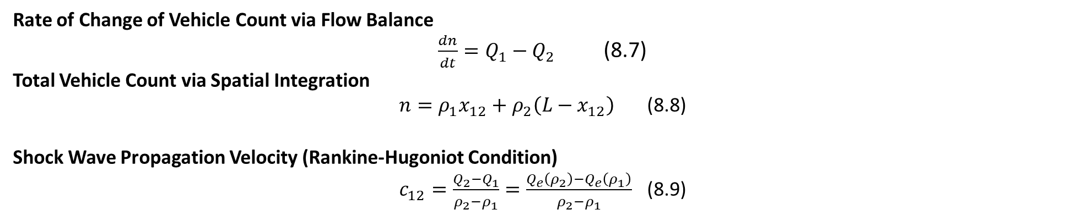
8.3.2 Shock Waves
rhodeskesi
Rate of Change of Vehicle Count via Flow Balance
$\frac{dn}{dt}=Q_{1}−Q_{2}$ (8.7)
Total Vehicle Count via Spatial Integration
$n=ρ_{1}x_{12}+ρ_{2}\left(L−x_{12}\right)$ (8.8)
Shock Wave Propagation Velocity (Rankine-Hugoniot Condition)
$c_{12}=\frac{Q_{2}−Q_{1}}{ρ_{2}−ρ_{1}}=\frac{Q_{e}\left(ρ_{2}\right)−Q_{e}\left(ρ_{1}\right)}{ρ_{2}−ρ_{1}}$ (8.9)

Slide 29
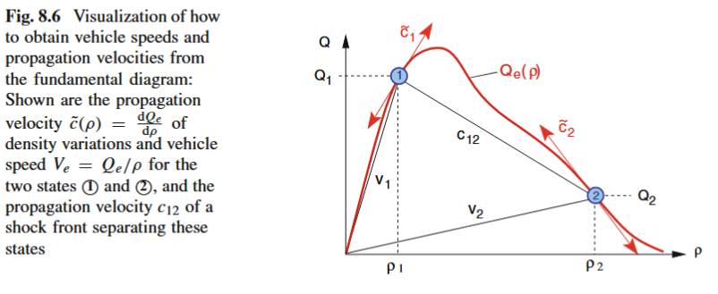
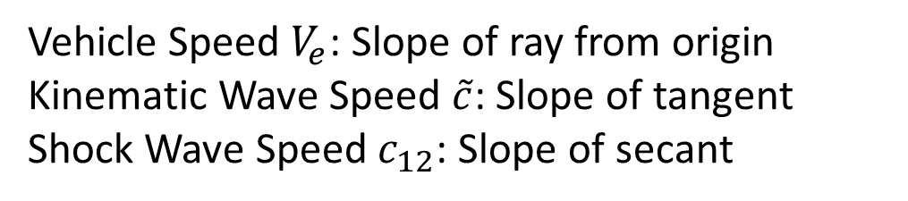
8.3.3 Shock Waves
rhodeskesi
Vehicle Speed $V_{e}$: Slope of ray from origin
Kinematic Wave Speed $\overset{˜}{c}$: Slope of tangent
Shock Wave Speed $c_{12}$: Slope of secant

